Slide 1
Scripting and DNS troubleshooting in a Linux environment
Members: Blake Samani

Slide 2
What this script does
Automates DNS troubleshooting
Multiple commands in one script given an IP/Domain
Two files
One gives output as a txt file
The other gives output to the console

Slide 3
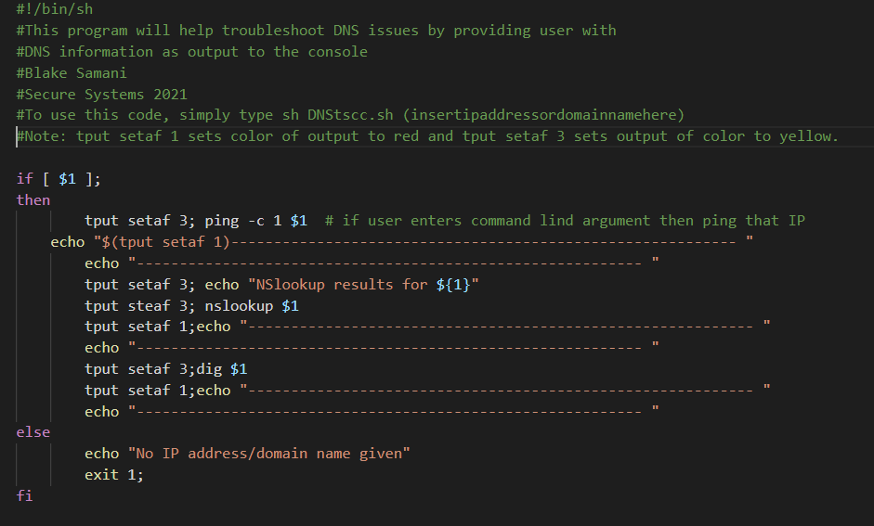
Design
DNStscc.sh
Script reads an IP address or domain name from the command line
If none given, the user will be informed, then the program exits.
When given a domain/IP, the program then runs the Ping command, Nslookup command, and dig command on that domain/IP.
This is output to the console in a readable format

Slide 4
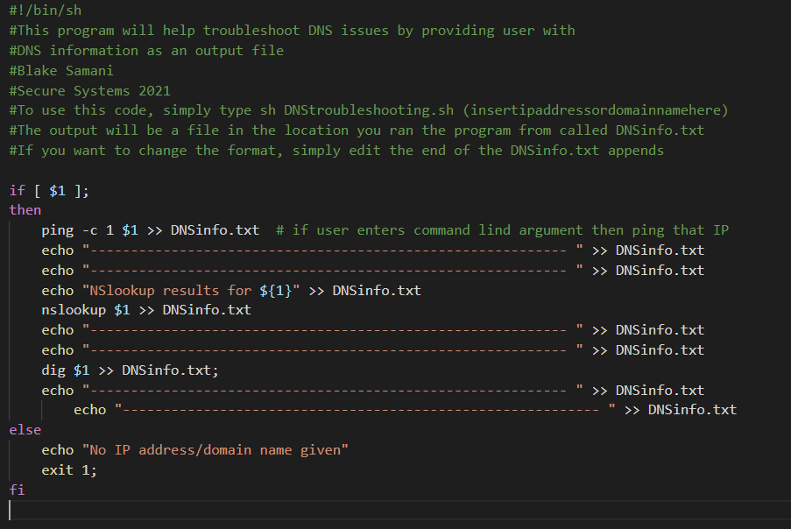
Design
DNStroubleshooting.sh
Same as previous example with 1 change
The info is output into a .txt file in a readable format

Slide 5
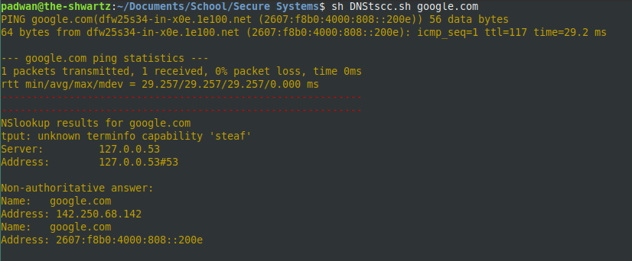
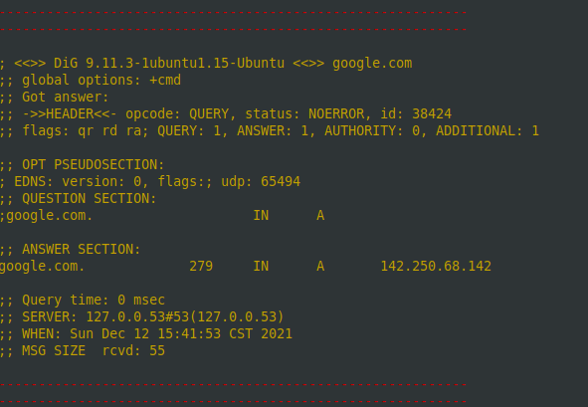
Implementation
DNStscc.sh
Output to console from using google.com as our command line argument

Slide 6
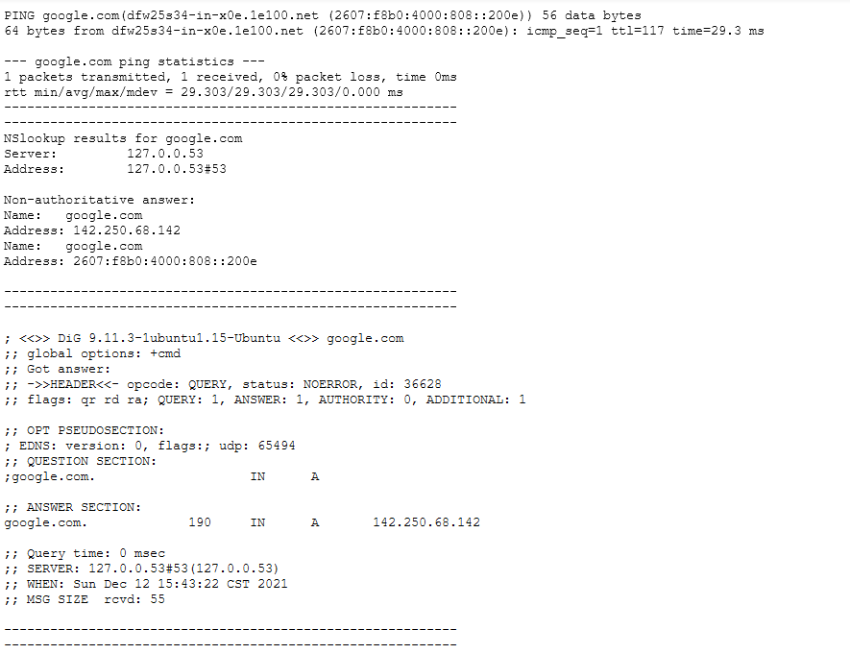
Implementation
DNStscc.sh
Output to .txt file using google.com as command line argument

Slide 7
Evaluation
Pros
Easy to run
Intuitive
Easy to edit
Simplistic
Saves time
Cons
Output could be interpreted in many ways
Output relies heavily on user knowledge

Slide 8
Conclusion
Being unable to access the internet is frustrating
With this tool, one can more readily diagnose DNS issues with a simple command
Not a unique solution, but a practical solution
Can save an administrator or user precious time

